Slide 1
Event Management System
By
Nadarajah Dheynoshan

Slide 2
Features
Add an event
Remove event
Update event
Display all the events
Make a booking for an Event
Cancel booking

Slide 3
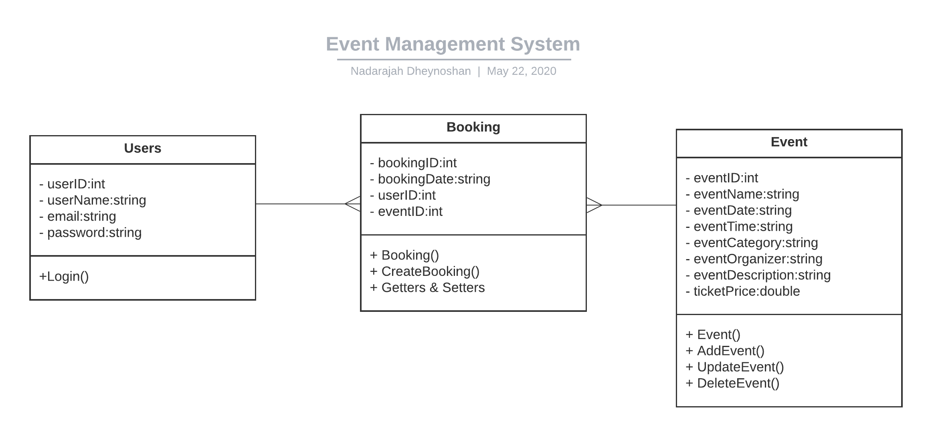
Class Diagram

